Slide 1
Single Particle cryo-EM Reconstruction
Li Minzhang
Notes:
大家好，我给大家介绍xxxxx

Slide 2
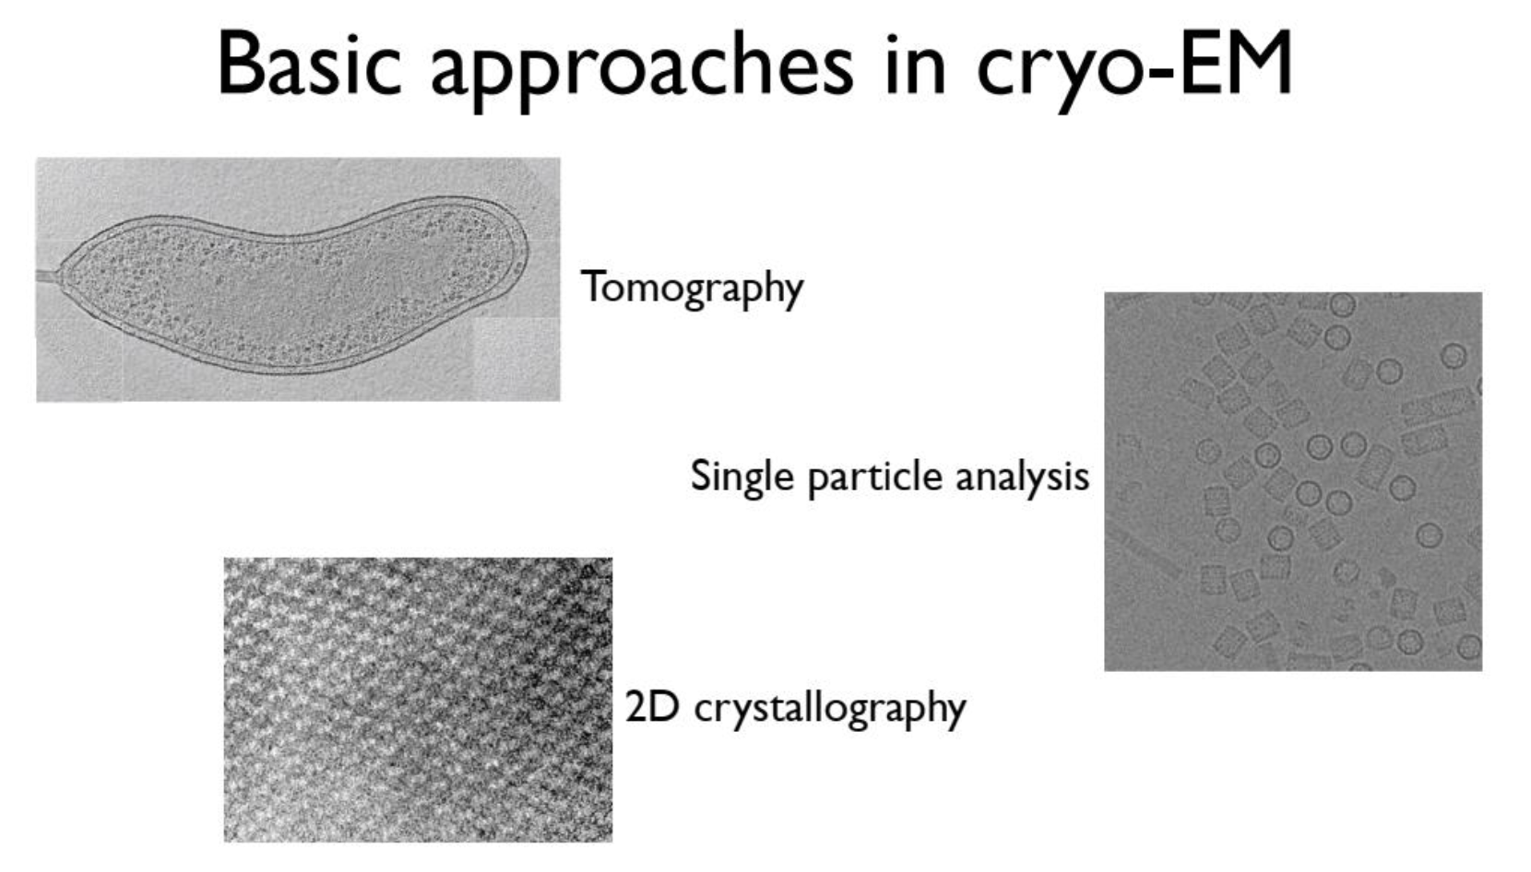
Recall
reference: Cryo-EM Imaging Basics,张晓骁
Notes:
上周张晓晓老师介绍了cryo-EM的基础问题和背景。他的PPT里讲到，cryoEM可以做XXX，XXX，XX。三个方向有异同，今天我会讲SPA，周三盈君会讲Tomography，马老师也许会讲材料相关的内容。

Slide 3
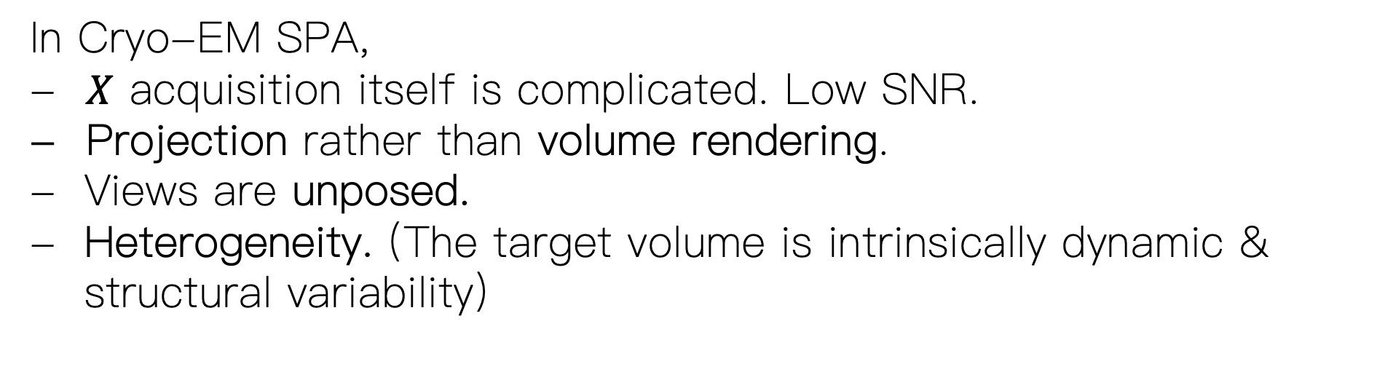
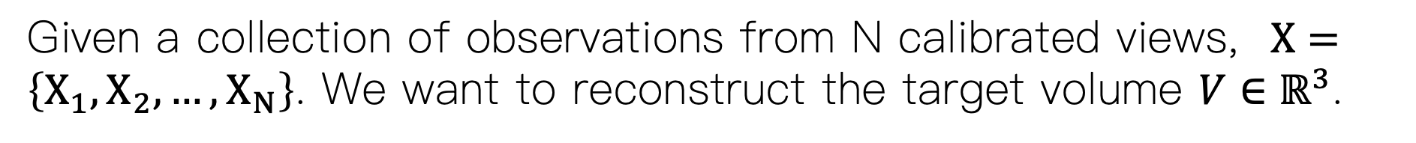
3D Reconstruction Problem Setting
Given a collection of observations from N calibrated views, $X=\left\{X_{1},X_{2},…, X_{N}\right\}$. We want to reconstruct the target volume $V∈ℝ^{3}$.
In Cryo-EM SPA,
- $X$ acquisition itself is complicated. Low SNR.
- Projection rather than volume rendering.
Views are unposed.
Heterogeneity. (The target volume is intrinsically dynamic & structural variability)

Slide 4
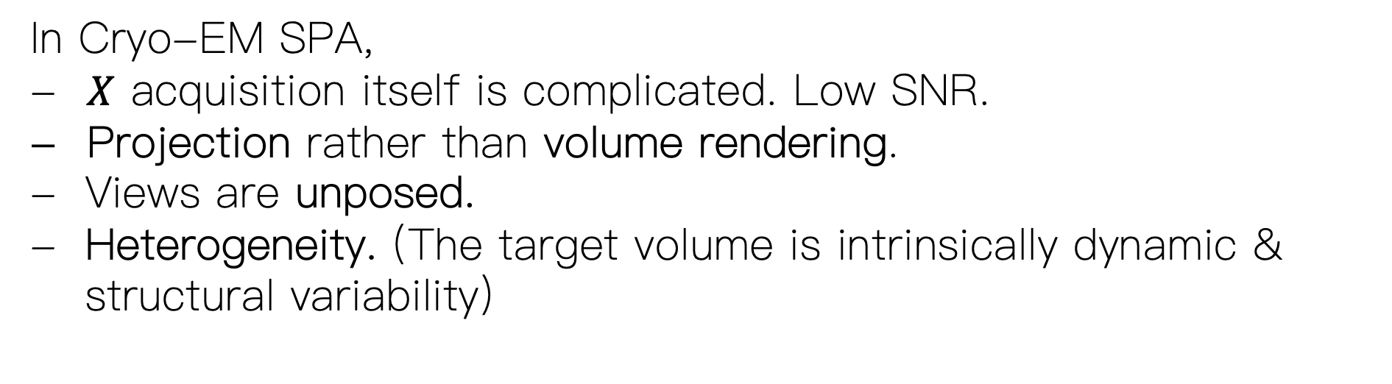
3D Reconstruction Problem Setting
In Cryo-EM SPA,
- $X$ acquisition itself is complicated. Low SNR.
- Projection rather than volume rendering.
Views are unposed.
Heterogeneity. (The target volume is intrinsically dynamic & structural variability)
Imagine NeRF reconstructing a dynamic object with completely unposed views of extremely low SNR.

Slide 5
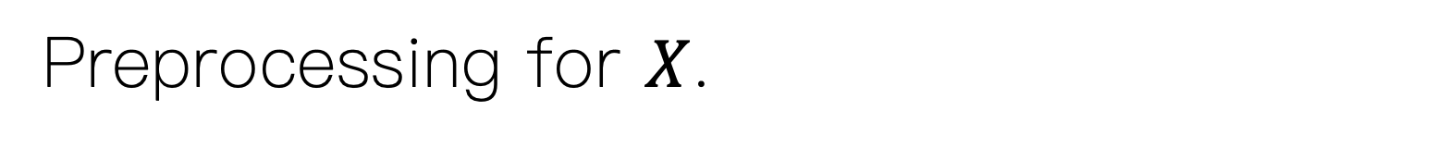
Preprocessing for $X$.
From movie frames to micrograph
Problem 1: Beam-induced motion. Solution: Motion correction.
Problem 2: Radiation damage. Solution: Dose weighting.
2. CTF estimation
Problem 3: Imperfect Imaging transfer. Solution: CTF.
Problem 4: Zero-crossings. Solution: Defocus range.
3. Particle Picking: Get mixed collections of different views
4. 2D/3D classification
Problem 5: Unknown Orientation. Solution: Cross-Correlation/EM

Slide 6
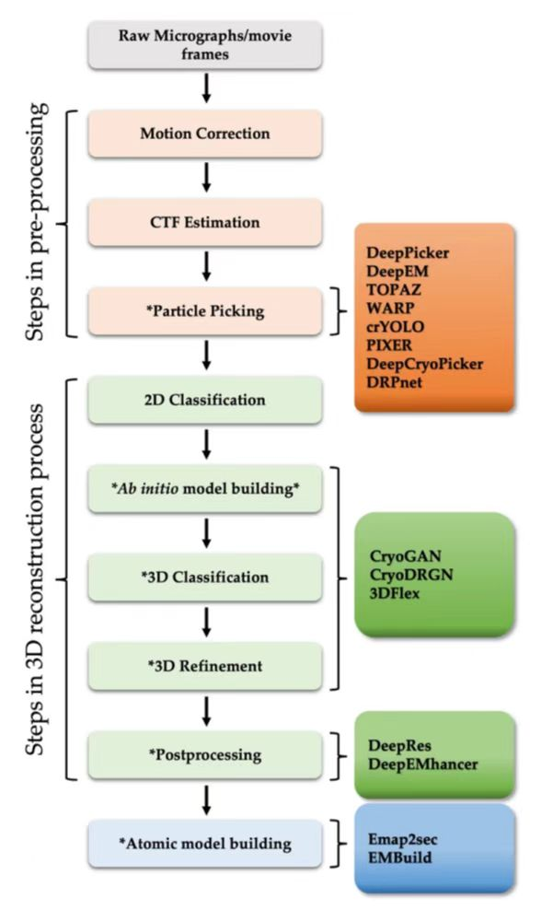
Workflow
Notes:
这是SPA的工作流。今天我的重心会放在最重建的部分XXXX。首先请大家看一个视频，以了解前面预处理的步骤。

Slide 7
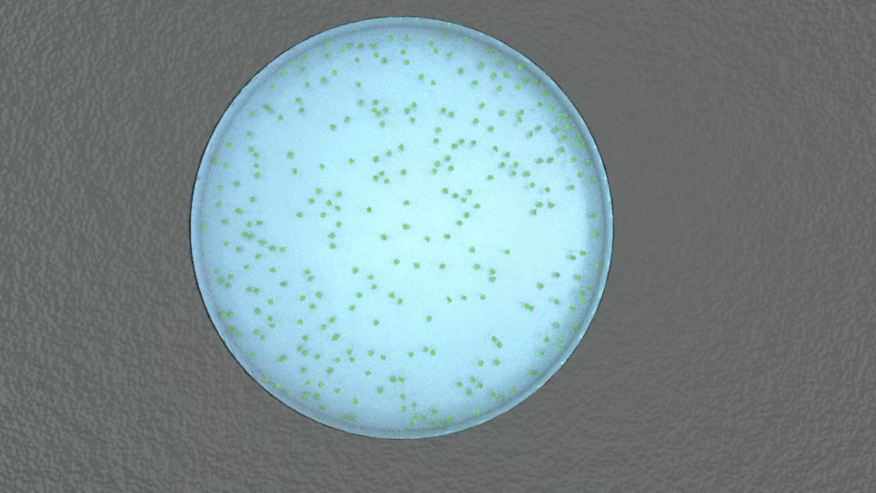
From movie frames to micrograph
Problem: Beam-induced motion
https://cryoem101.org/chapter-5/

Slide 8
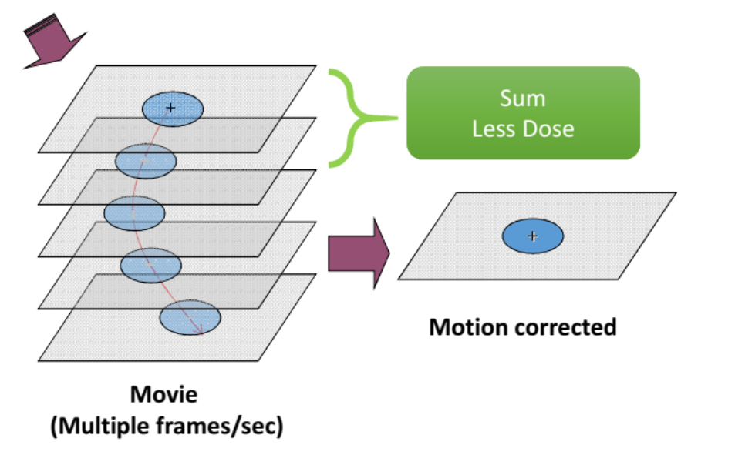
From movie frames to micrograph
For an exposure series, the direct detectors of high fps allows cryo-EM data to be recorded in the form of movies.
Factors:
FPS.
Dose.
Carbon support and ice.

Slide 9


Slide 10
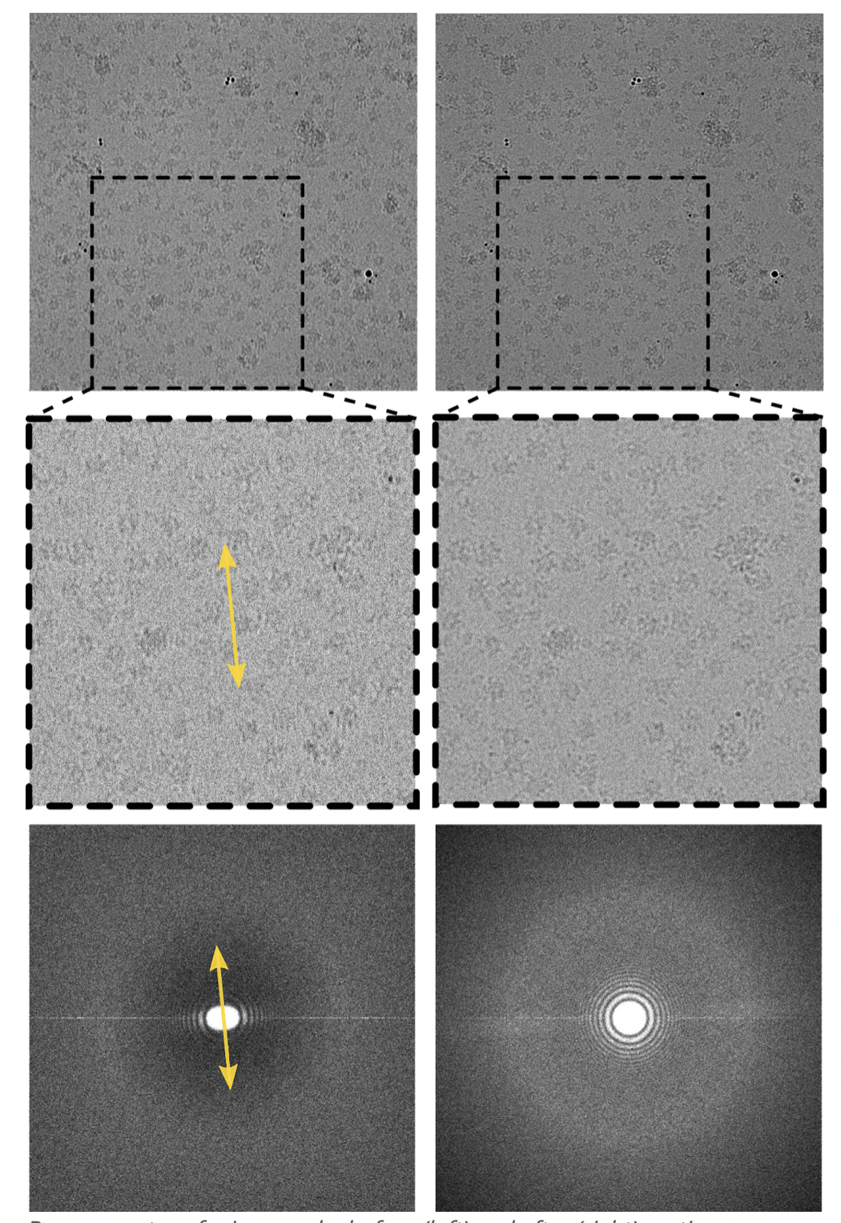
From Movies to micrograph
Left: Before motion correction
Right: After motion correction
Notes:
上周张晓晓老师介绍了cryo-EM的基础问题和背景。他的PPT里讲到，cryoEM可以做XXX，XXX，XX。三个方向有异同，今天我会讲SPA，周三盈君会讲Tomography，马老师也许会讲材料相关的内容。

Slide 11
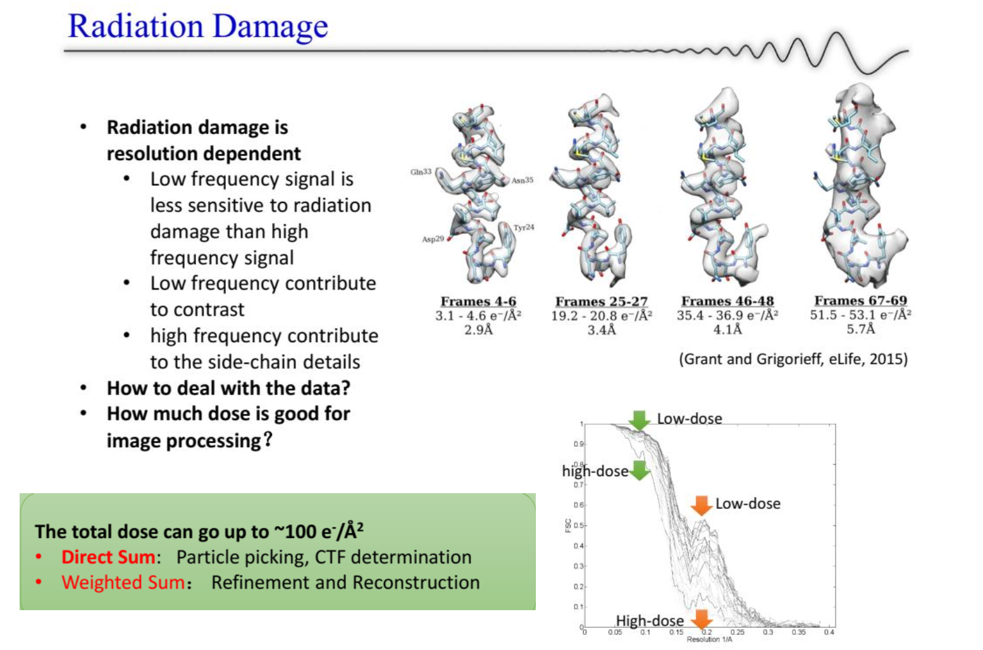

Slide 12
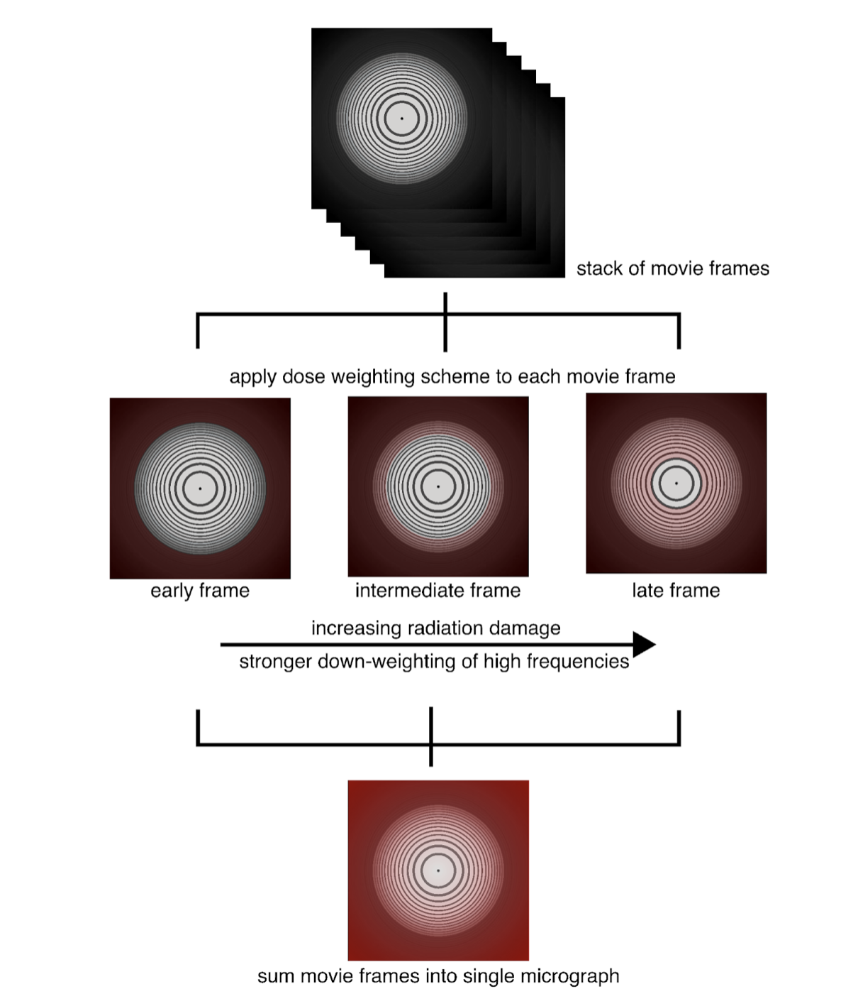
Dose Weighting (exposure filtering)
Problem: Radiation Damage
Early frames have accurate info but low contrast, late frames have good contrast but less info.
Notes:
上周张晓晓老师介绍了cryo-EM的基础问题和背景。他的PPT里讲到，cryoEM可以做XXX，XXX，XX。三个方向有异同，今天我会讲SPA，周三盈君会讲Tomography，马老师也许会讲材料相关的内容。

Slide 13
Workflow
Workflow
reference: Cryo-EM Imaging Basics,张晓骁
Notes:
首先我们recall一下，SPA的工作流。

Slide 14
Preprocessing for $X$.
From movie frames to micrograph
Problem 1: Beam-induced motion. Solution: Motion correction.
Problem 2: Radiation damage. Solution: Dose weighting.
2. CTF estimation
Problem 3: Imperfect Imaging transfer. Solution: CTF.
Problem 4: Zero-crossings. Solution: Defocus range.
3. Particle Picking: Get mixed collections of different views
4. 2D/3D classification
Problem 5: Unknown Orientation. Solution: Cross-Correlation/EM

Slide 15
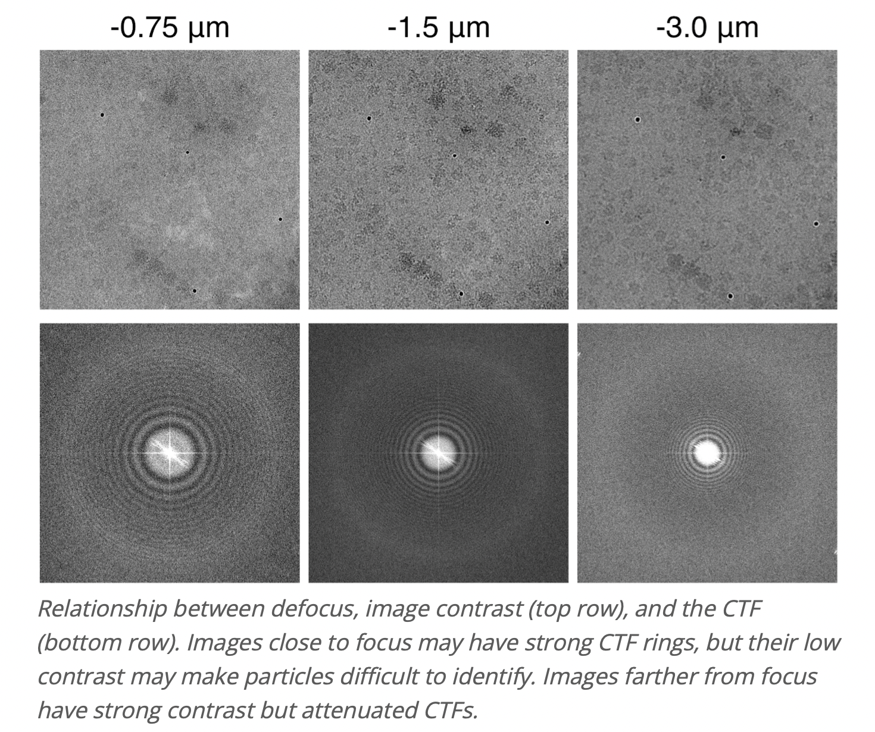
CTF estimation
reference: Cryo-EM Imaging Basics,张晓骁

Slide 16
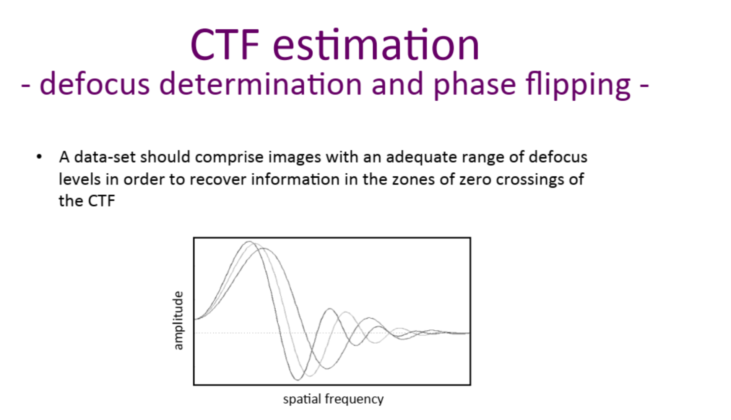
CTF estimation – zero-crossings
reference: Cryo-EM Imaging Basics,张晓骁

Slide 17
Preprocessing for $X$.
From movie frames to micrograph
Problem 1: Beam-induced motion. Solution: Motion correction.
Problem 2: Radiation damage. Solution: Dose weighting.
2. CTF estimation
Problem 3: Imperfect Imaging transfer. Solution: CTF.
Problem 4: Zero-crossings. Solution: Defocus range.
3. Particle Picking: Get mixed collections of different views
4. 2D/3D classification
Problem 5: Unknown Orientation. Solution: Cross-Correlation/EM

Slide 18
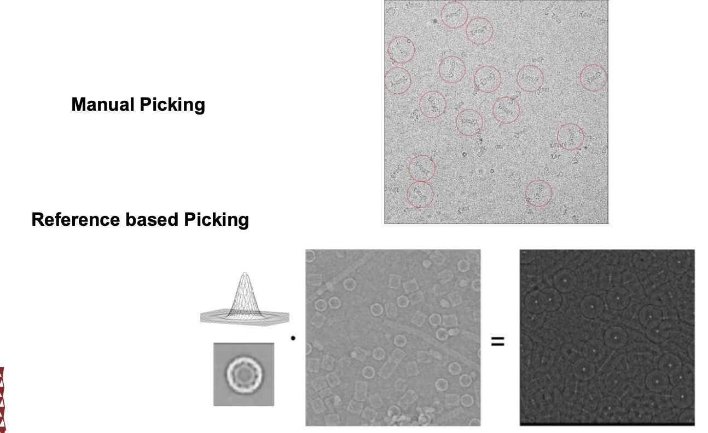
Particle Picking
reference: Cryo-EM Imaging Basics,张晓骁

Slide 19
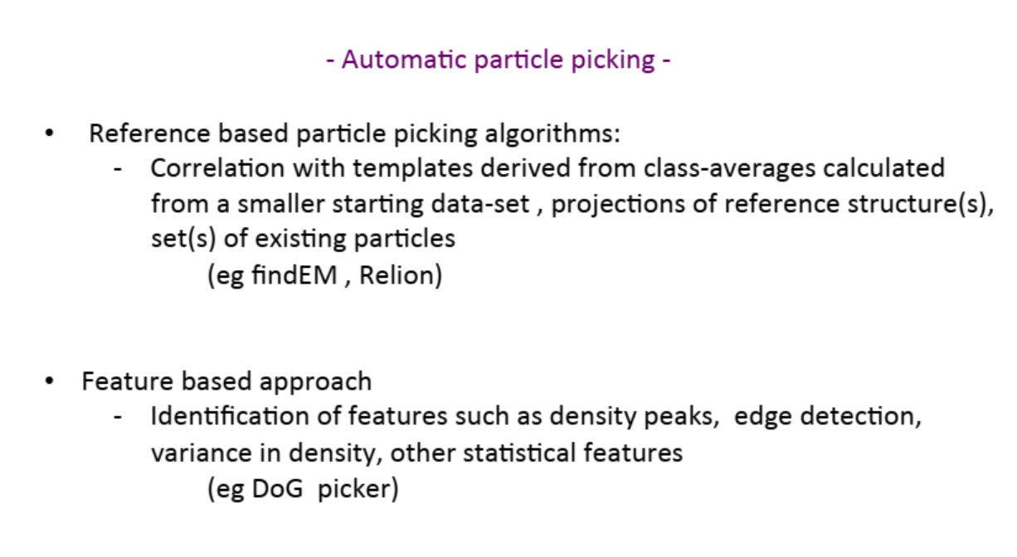
Particle Picking
reference: Cryo-EM Imaging Basics,张晓骁

Slide 20
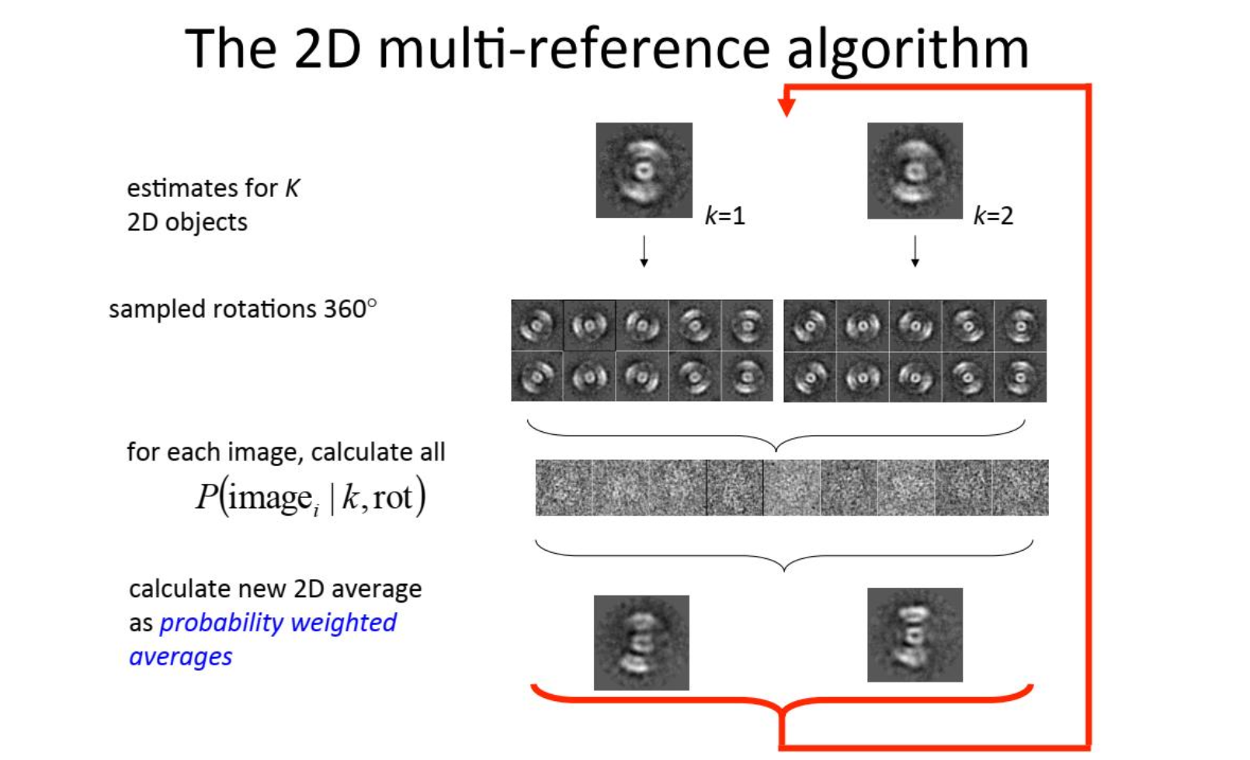
2D Classification
reference: Cryo-EM Imaging Basics,张晓骁

Slide 21
3D Reconstruction Problem Setting
In Cryo-EM SPA,
- $X$ acquisition itself is complicated. Low SNR.
- Projection rather than volume rendering.
Views are unposed.
Heterogeneity. (The target volume is intrinsically dynamic & structural variability)
Imagine NeRF reconstructing a dynamic object with completely unposed views of extremely low SNR.

Slide 22
Workflow
Notes:
这是SPA的工作流。今天我的重心会放在最重建的部分XXXX。首先请大家看一个视频，以了解前面预处理的步骤。

Slide 23
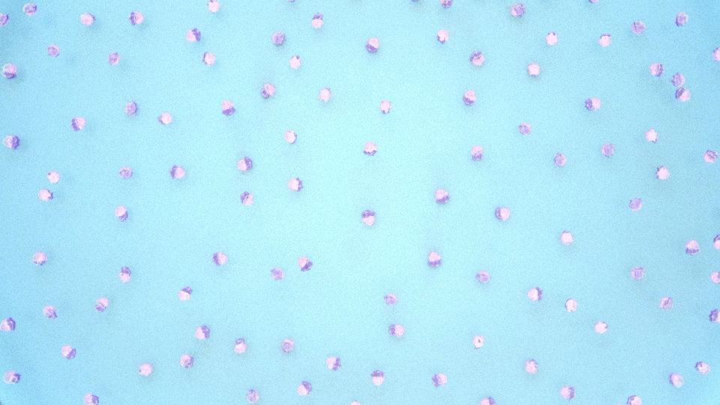
Core problem: 3D Reconstruction

Slide 24
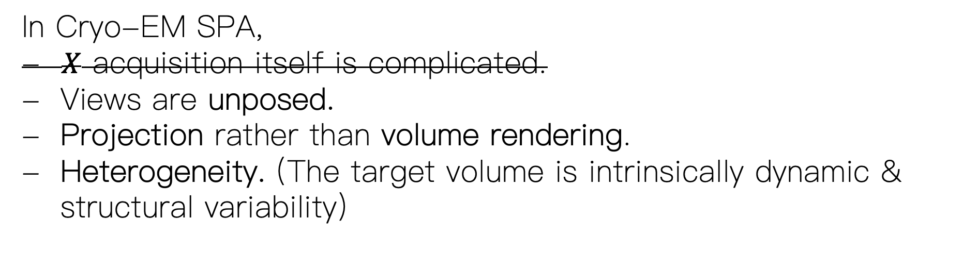
Core problem: 3D Reconstruction
In Cryo-EM SPA,
- $X$ acquisition itself is complicated.
Views are unposed.
Projection rather than volume rendering.
Heterogeneity. (The target volume is intrinsically dynamic & structural variability)

Slide 25
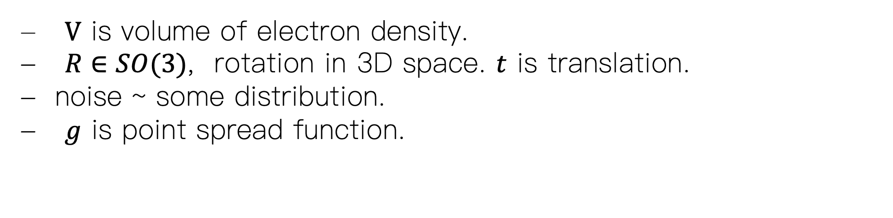
Image Forward Model
$V$ is volume of electron density.
$R∈SO(3)$, rotation in 3D space. $t$ is translation.
noise ~ some distribution.
$g$ is point spread function.

Slide 26
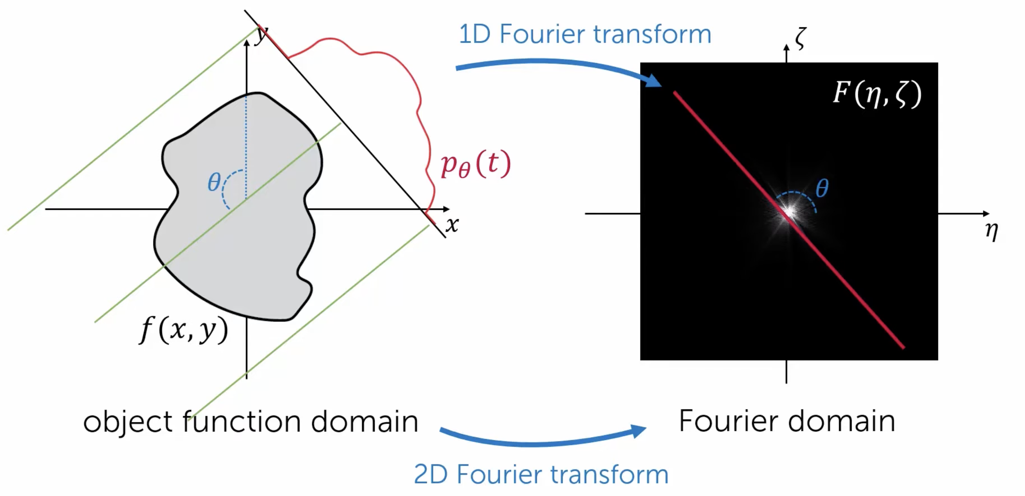
Fourier Slice Theorem
The Fourier transform of a 1D projection of V is a 1D slice through the origin of V​ in the Fourier domain, where the slice is perpendicular to the projection direction.

Slide 27
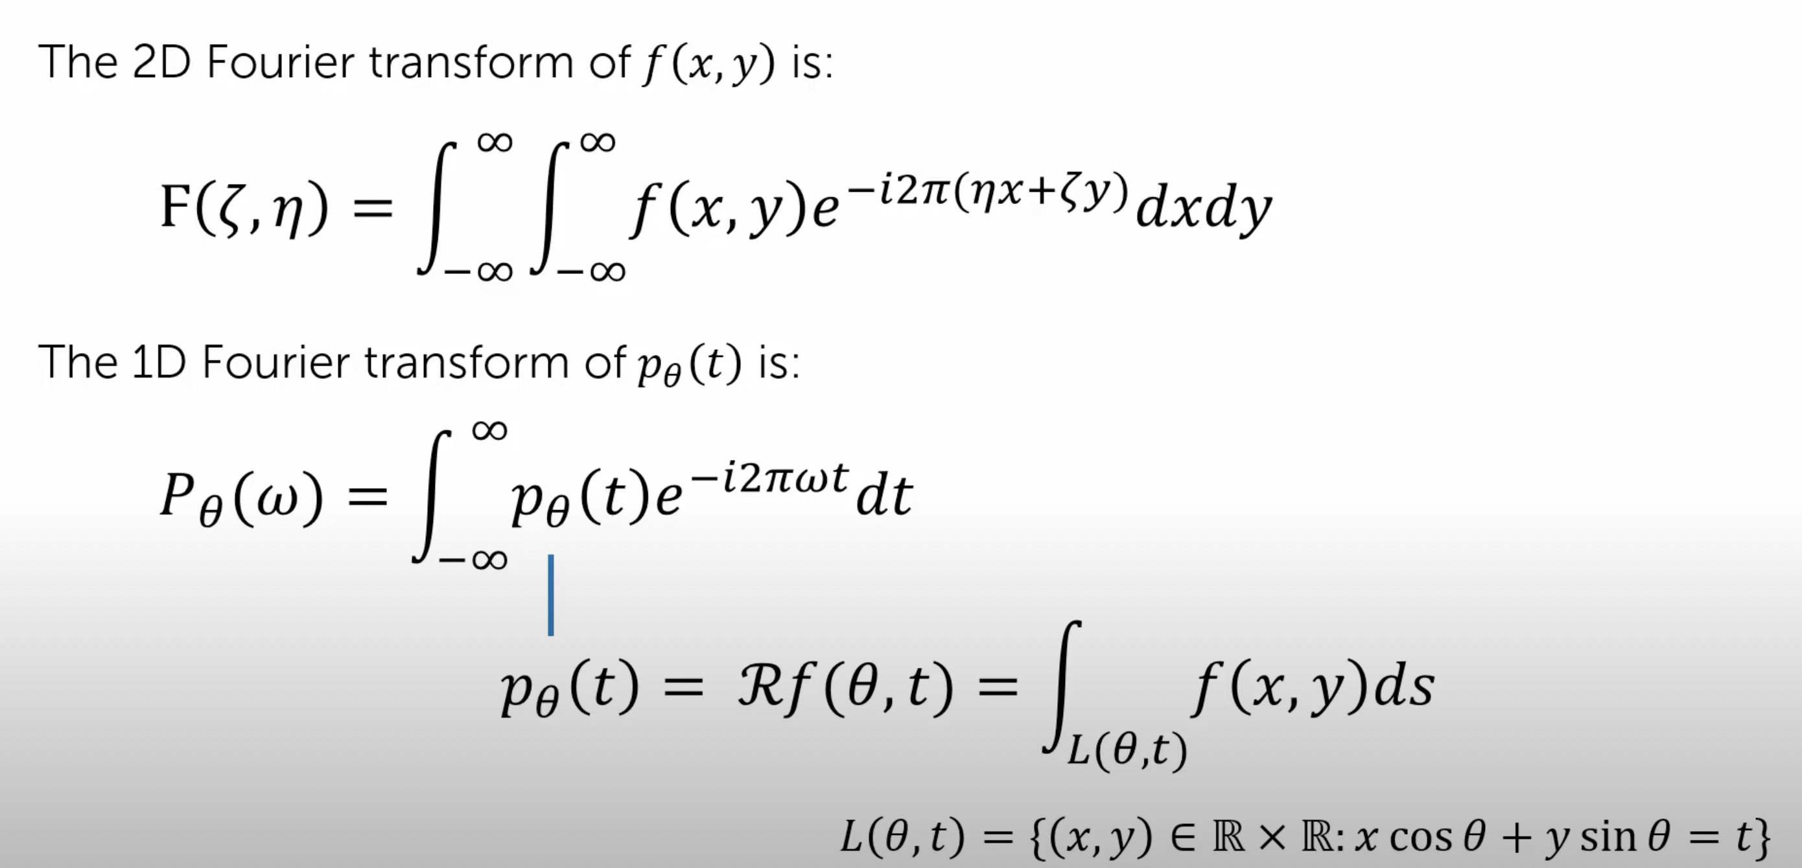
Proof of Fourier Slice Theorem

Slide 28
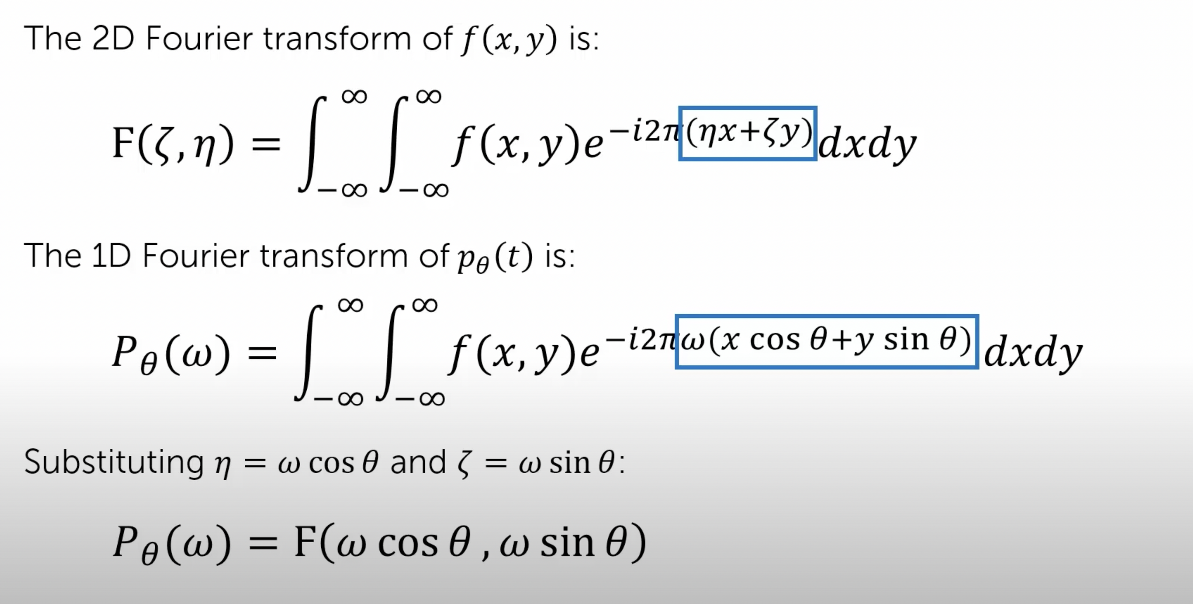
Proof of Fourier Slice Theorem

Slide 29
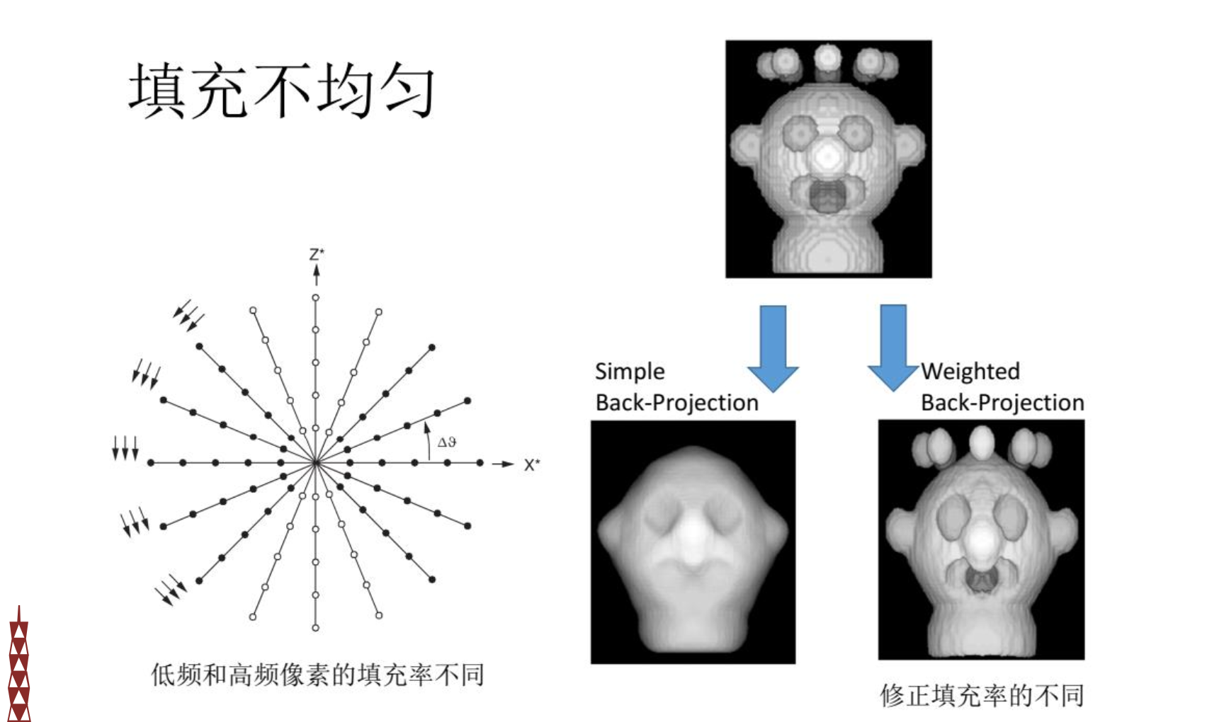
Problem of Applying FST
Problem :
- Uneven frequency
Missing-wedges
Not directly suitable for FFT
reference: Cryo-EM Imaging Basics,张晓骁

Slide 30
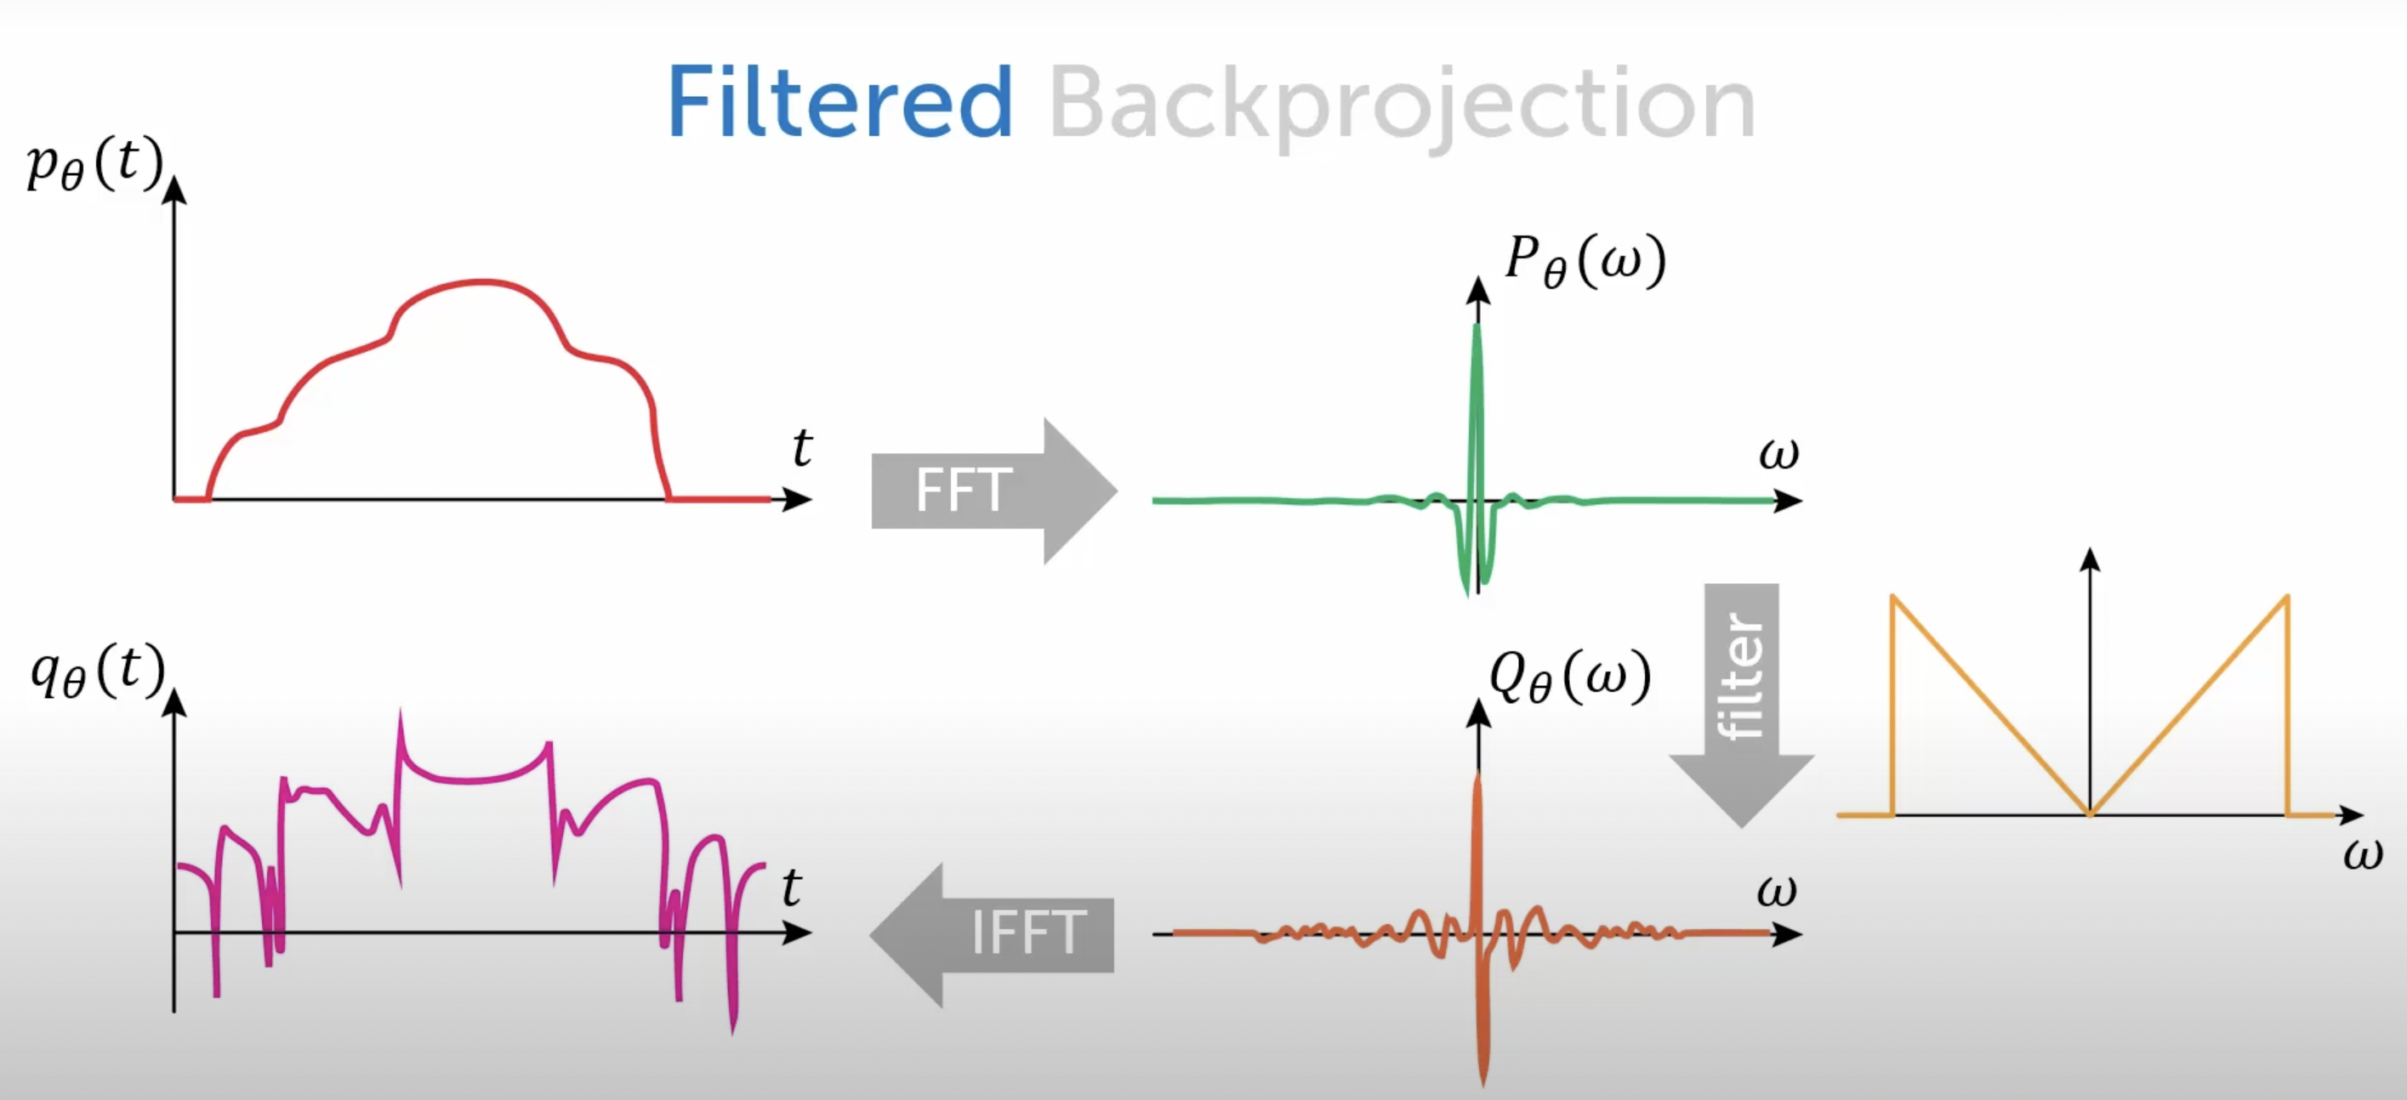
Filtered BP

Slide 31
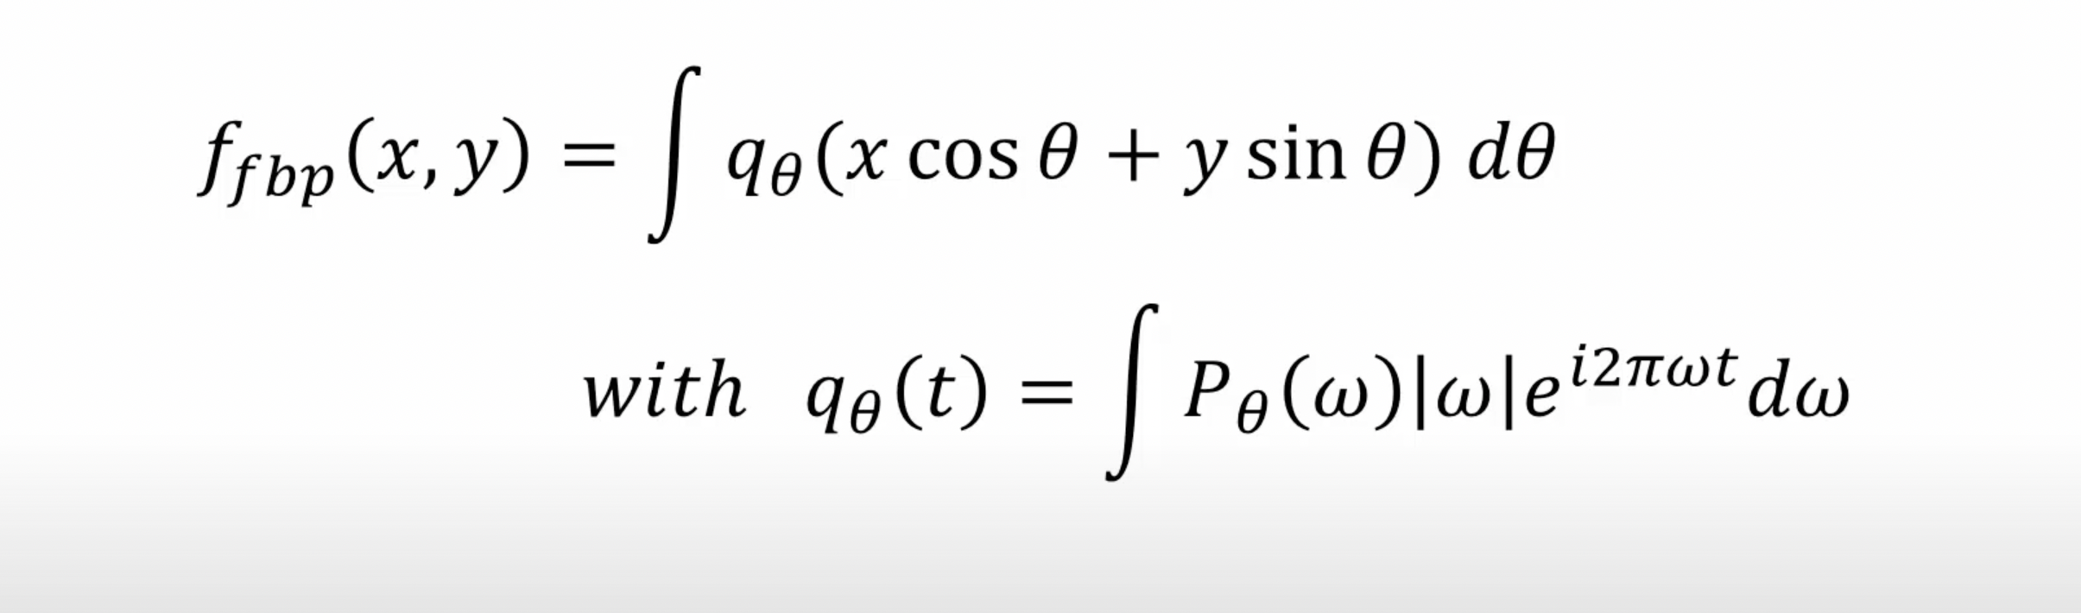
Filtered BP

Slide 32
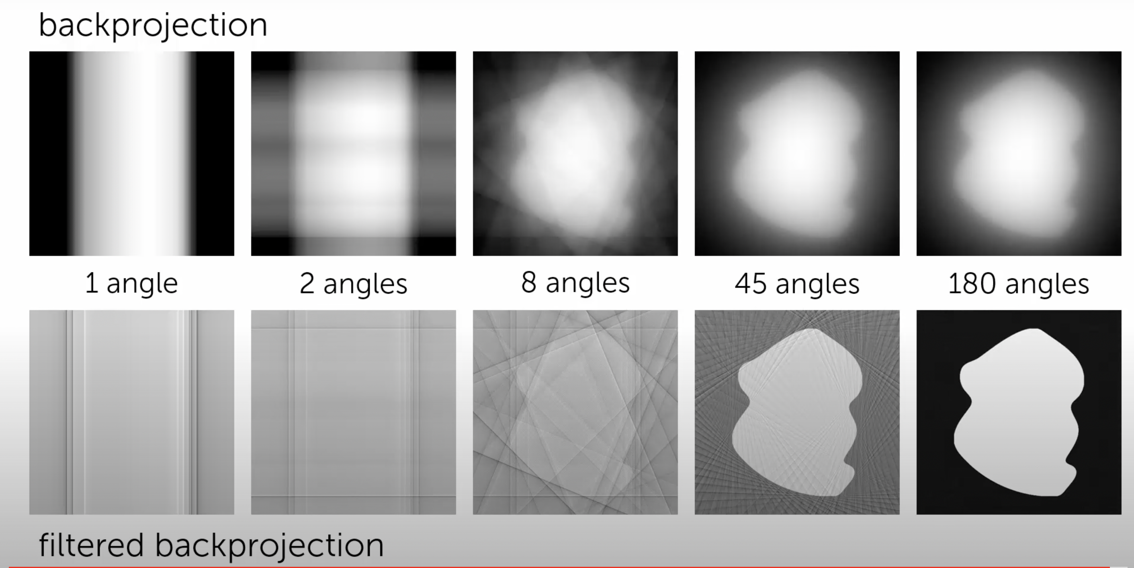
Filtered BP

Slide 33
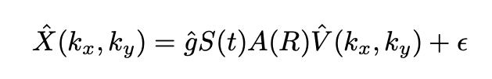
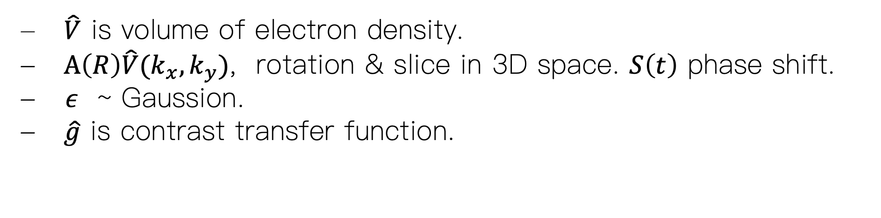
Formation Model in Fourier Domain
$\hat{V}$ is volume of electron density.
$A\left(R\right)\hat{V}(k_{x},k_{y})$, rotation & slice in 3D space. $S\left(t\right)$ phase shift.
- $ε$ ~ Gaussion.
$\hat{g}$ is contrast transfer function.

Slide 34
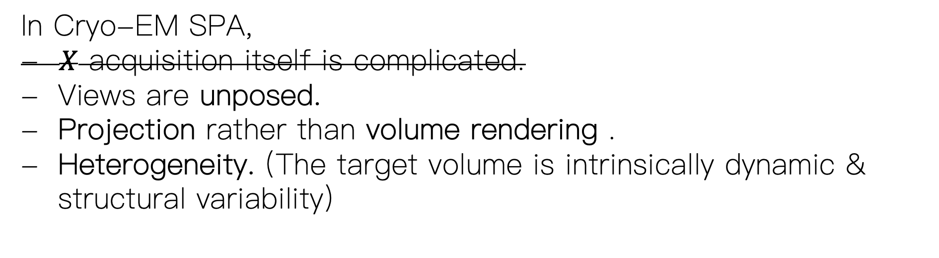
Core problem: 3D Reconstruction
In Cryo-EM SPA,
- $X$ acquisition itself is complicated.
Views are unposed.
Projection rather than volume rendering .
Heterogeneity. (The target volume is intrinsically dynamic & structural variability)

Slide 35
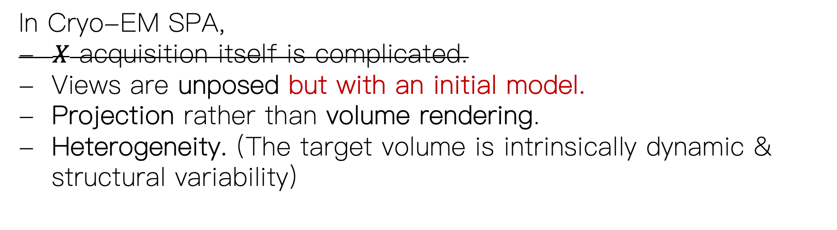
Core problem: 3D Reconstruction
In Cryo-EM SPA,
- $X$ acquisition itself is complicated.
Views are unposed but with an initial model.
Projection rather than volume rendering.
Heterogeneity. (The target volume is intrinsically dynamic & structural variability)
Given a good initial model,
we may apply Expectation-maximization approach

Slide 36
Core problem: 3D Reconstruction
In Cryo-EM SPA,
- $X$ acquisition itself is complicated.
Views are unposed but with an initial model.
Projection rather than volume rendering.
Heterogeneity. (The target volume is intrinsically dynamic & structural variability)
Can we have Bayesian view of the image formation model
in Fourier Domain?

Slide 37
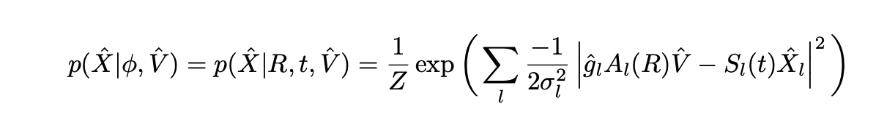
Bayesian view: image formation
$\hat{V}$ is volume of electron density.
$A\left(R\right)\hat{V}(k_{x},k_{y})$, rotation & slice in 3D space. $S\left(t\right)$ phase shift.
- $ε$ ~ Gaussion.
$\hat{g}$ is contrast transfer function.

Slide 38
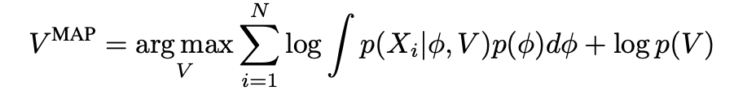
Bayesian view: object function & MAP
What about heterogeneity?

Slide 39
Core problem: 3D Reconstruction
In Cryo-EM SPA,
- $X$ acquisition itself is complicated.
Views are unposed.
Projection rather than volume rendering .
Heterogeneity. (The target volume is intrinsically dynamic & structural variability)

Slide 40
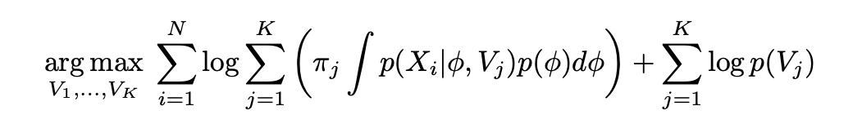
Bayesian view: object function & MAP

Slide 41
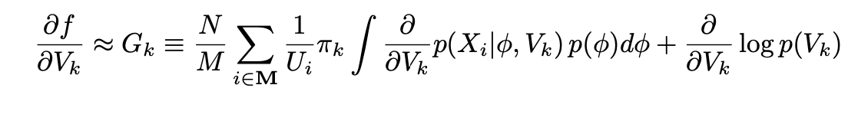
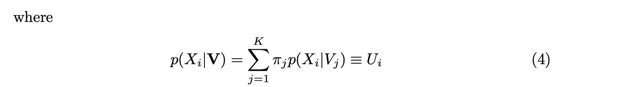
Stochastic Gradient Method for EM

Slide 42
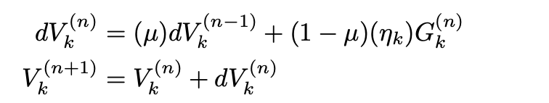
Stochastic Gradient Method for EM

Slide 43
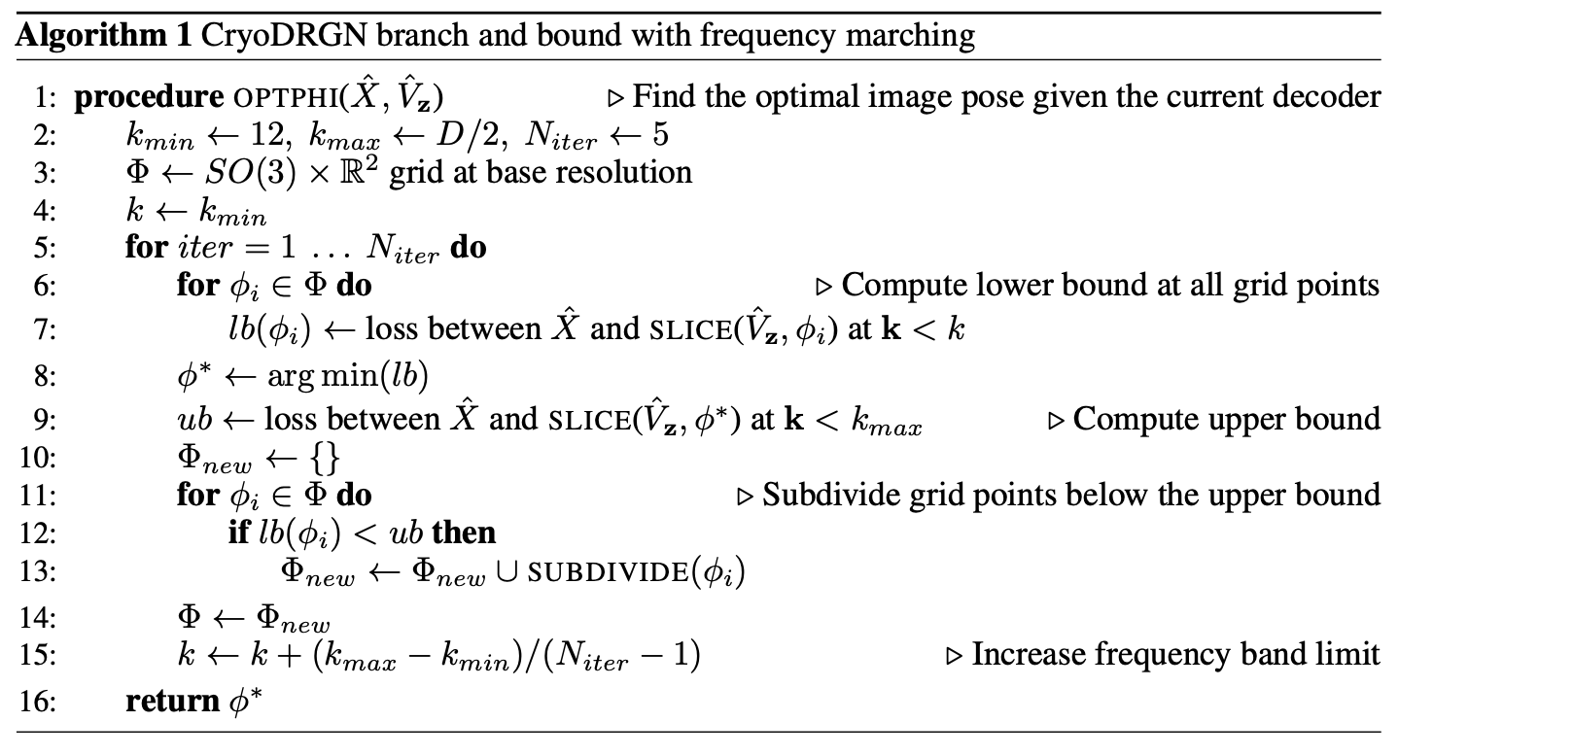

Pose Search
What about pose? Inference over SO(3) $× ℝ^{2}$.

Slide 44
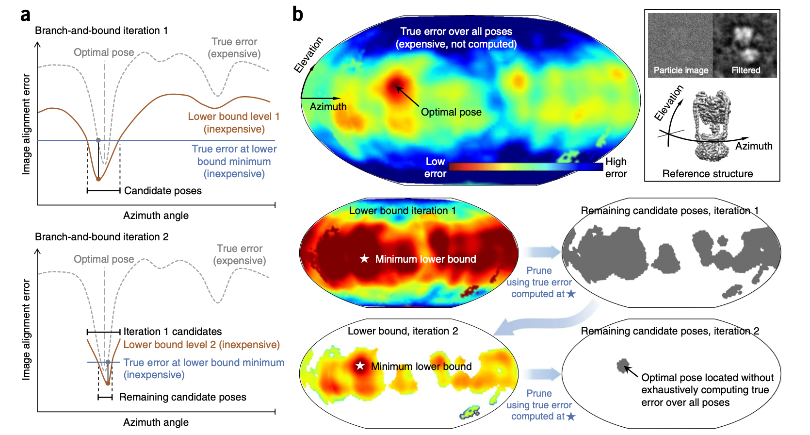
Pose Search

Slide 45
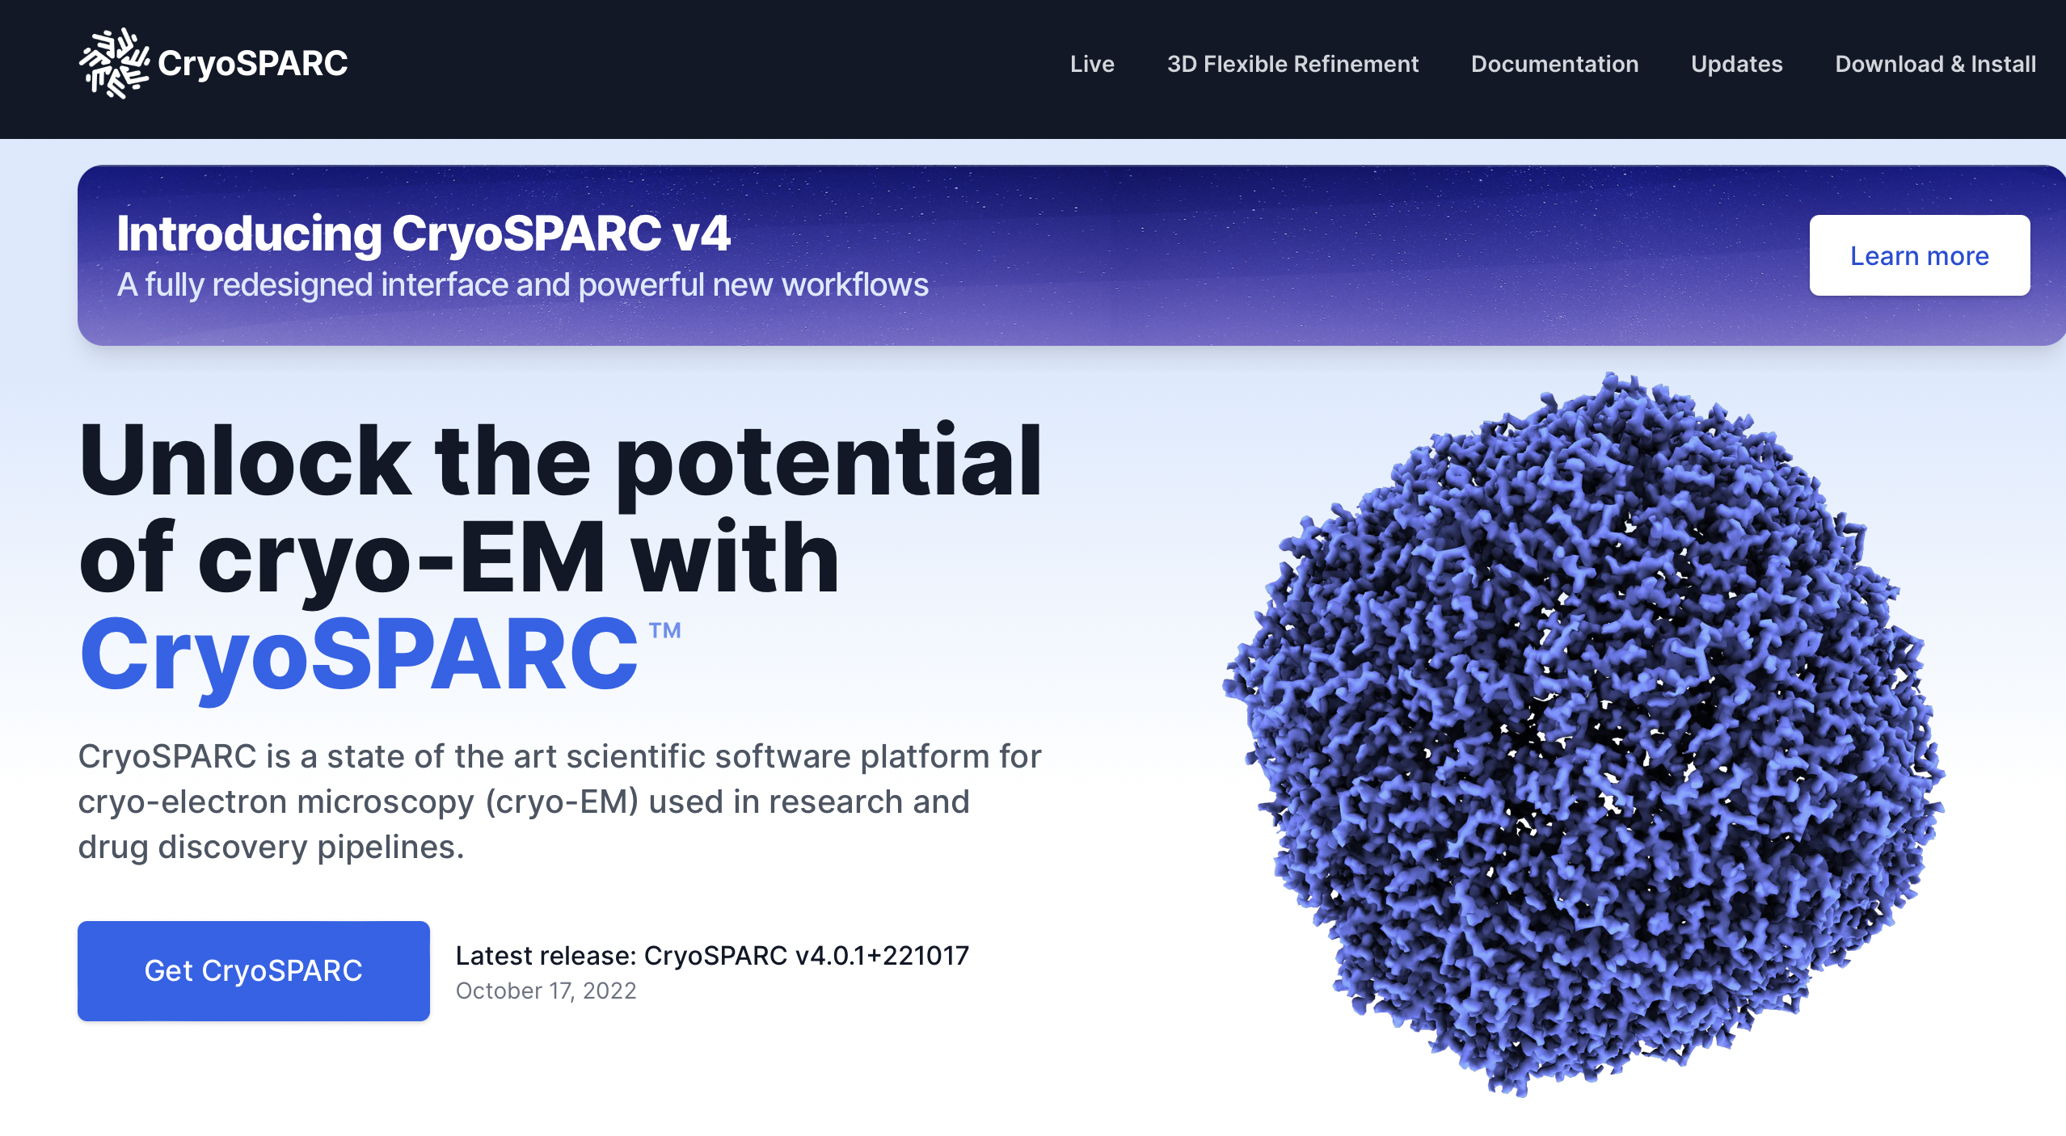

Slide 46
Core problem: 3D Reconstruction
In Cryo-EM SPA,
- $X$ acquisition itself is complicated.
Views are unposed but with an initial model.
Projection rather than volume rendering.
Heterogeneity. (The target volume is intrinsically dynamic & structural variability)
Given a good initial model,
we may apply Expectation-maximization approach

Slide 47
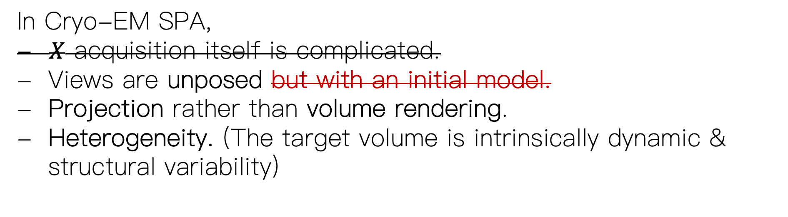
What can be improved?
In Cryo-EM SPA,
- $X$ acquisition itself is complicated.
Views are unposed but with an initial model.
Projection rather than volume rendering.
Heterogeneity. (The target volume is intrinsically dynamic & structural variability)
How to get ab initio model?
Given a good initial model,
we may apply Expectation-maximization approach

Slide 48
What can be improved?
1. Highly nonconvex. Need good initialization.
2. Heterogeneity is not continuous here & needs prior knowledge from expert to select K templates.

Slide 49
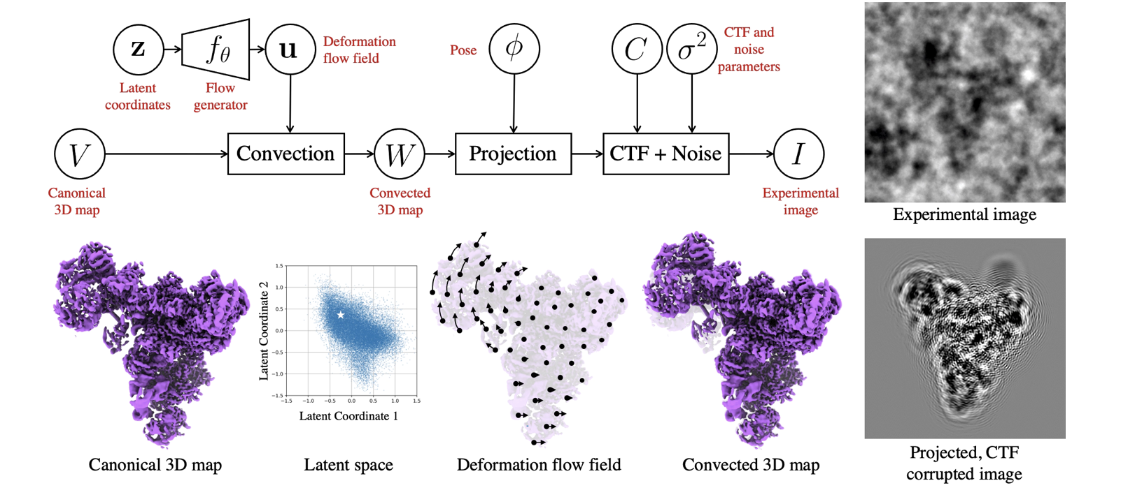
CryoSPARC-3DFlex
2. Heterogeneity is not continuous here & needs prior knowledge from expert to select K templates.

Slide 50
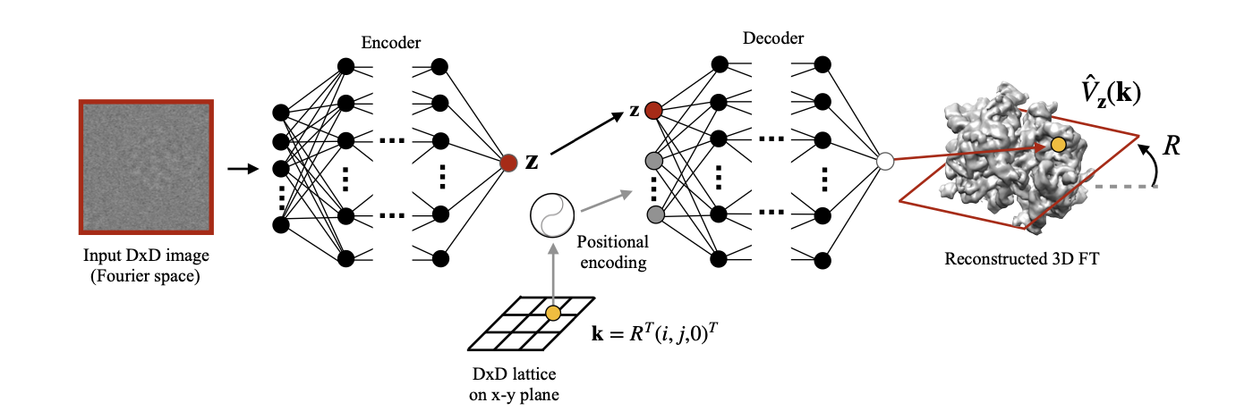
CryoDRGN

Slide 51
Promising Area:
Cryo-EM + CV/CG/CP + DL

